Slide 1
第一章 导论

Slide 2
提纲
什么是传播学？
计算传播学之于传统传播学：新的研究范式
传统传播学之于计算传播学：经典理论

Slide 3
To begin with…
“计算社会科学”自提出始，就是一个跨学科研究领域。
重要的研究问题是跨越学科的
信息传播、社会公平与分配
无法精确界定某一个问题／研究只属于“计算传播学”领域
传播学期刊中的非典型传播学问题
非传播学期刊中的典型传播问题
Notes:
本人甚至比较反对“计算传播学”的提法；而更倾向于“计算社会科学”这一笼统的范畴。
重要的研究问题是跨越学科的（比如，信息传播、社会公平与分配）
而只能对研究问题／研究成果做出一个大致的范畴划分

Slide 4
什么是传播学？
第一部分

Slide 5
什么是传播学？
传播学是一门研究人类一切传播行为、传播过程及其规律的科学。
运用不同的模式来解释信息传播的机制和本质，描绘传播过程与传播效果，预测未来传播的形势和结构等
Interpersonal Communication
Group Communication
Mass Communication
Notes:
传播学： 广义：疾病传播、
狭义： 信息传播。
人际传播：
组织传播：组织机构、公关研究
大众传播：“一对多”广播式 （竞选）

Slide 6
Divisions in ICA
Instructional and Developmental Communication
Intercultural Communication
Interpersonal Communication
Journalism Studies
Language and Social Interaction
Mass Communication
Organizational Communication
Philosophy, Theory and Critique
Political
Popular Communication
Public Relations
Visual Communication Studies
Children, Adolescents and Media
Communication and Technology
Communication History
Communication Law and Policy
Computational Methods
Environmental Communication
Ethnicity and Race in Communication
Feminist Scholarship
Game Studies
Global Communication and Social Change
Health Communication
Information Systems

Slide 7
第67届国际传播学会（ICA 2017）Panel数

Slide 8
传统传播学研究的两种范式
诠释意义（Interpretative）
What does it mean to us, given Y or X causing Y?
定性研究（qualitative）
寻找因果（Explanatory）
Why it happens (= Does X cause Y)
定量研究（quantitative）
转引自（祝建华，2017，兰州）
Notes:
预测性研究很少
诠释意义：不可证伪 eg “媒介即人的延伸”；
“媒介即讯息”： 媒介形式的变革导致感知世界的方式和行为发生变革，思维方式和行为习惯。 媒介加速并扩大人的功能。新的媒介导致在感知、思考引入了新的尺度、速度和模式。

Slide 9
传播学及其他社会科学研究数据来源
转引自（祝建华，2017，兰州）

Slide 10
计算传播学之于传统传播学： 新的研究范式
第二部分

Slide 11
传统传播学／社会科学的研究缺陷
Over-emphasize of Theories /Hypothesis
Over the past century, there has been no shortage of social theory, but there have been severe constraints on access to data. (Golder & Macy, 2014)
Notes:
Continuous-time location information
Online behavior—time-stamped and passively recorded—provides an unambiguous recording of when, and with whom,
each individual communicated.
Cell phones, IP address, Video Surveillance
Information about political preferences
Personal-level voter registration,
Unstructured textual data
Commercial information
Credit card, real estate purchases, wealth indicators, online product searches and purchases, device fingerprinting
Health information
Electronic medical records, devices for continuous monitoring
Why Computational Social Science?
Solution oriented.
microscopes to microbiologists
Social scientists are getting to the point in many areas at which enough information exists to understand and address major previously intractable problems that affect human society.
E.g., Crime:
Victimization surveys v.s. Huge quantities of real-time geocoded incident reports

Slide 12
Let’s Shake Up the Social Sciences
The social sciences have stagnated. They offer essentially the same set of academic departments and disciplines that they have for nearly 100 years: economics, anthropology… This is not only boring but also counterproductive, constraining engagement with the scientific cutting edge and stifling the creation of new and useful knowledge. Such inertia reflects an unnecessary insecurity and conservatism, and helps explain why the social sciences don’t enjoy the same prestige as the natural sciences.
Interdisciplinary efforts are generating practical insights about fundamental problems like chronic illness, energy conservation, pandemic disease, intergenerational poverty and market panics. For example, a better understanding of the structure and function of human social networks is helping us understand which individuals within social systems have an outsize impact when it comes to the spread of germs or the spread of ideas.
It is time to create new social science departments that reflect the breadth and complexity of the problems we face as well as the novelty of 21st-century science.
Biosocial science, network science, neuroeconomics, behavioral genetics and computational social science.
Nicholas A. Christakis, a physician and sociologist at Yale University, is a co-director of the Yale Institute for Network Science.

Slide 13
Computational Social Sciences
A field is emerging that leverages the capacity to collect and analyze data at a scale that may reveal patterns of individual and group behaviors.
The emerging field of computational social science (Lazer et al. 2009) is concerned with computational methods to collect, manipulate, and manage massive amounts of data, as well as with employing the appropriate techniques to derive inferences, such as automated content classification and topic modeling, natural language processing, simulation, and statistical models for analyzing non-independent observations (Anderson et al. 1999).
Notes:
作者之二为传播学领域

Slide 14
新的数据形式与来源
Continuous-time location information
Online behavior—time-stamped and passively recorded—provides an unambiguous recording of when, and with whom,
each individual communicated.
Cell phones, IP address, Video Surveillance
Information about political preferences
Personal-level voter registration,
Unstructured textual data
Commercial information
Credit card, real estate purchases, wealth indicators, online product searches and purchases, device fingerprinting
Health information
Electronic medical records, devices for continuous monitoring
Why Computational Social Science?

Slide 15
Why Now (King, 2011) ?
Spatial and Temporal
Frontiers in studying human behavior
Social life is very hard to observe
Small bounded groups
Interactions
Allow researchers to relax the atomistic assumptions that are imposed by reliance on random samples.
Random Sample: The assumption of independence
Unobstrusively observation
E.g., online dating sites
Robnett and Feliciano (Feliciano et al. 2009, Robnett & Feliciano 2011) found that, among those Whites who stated racial preferences in their online profiles, men were more likely to exclude Blacks than other racial categories, whereas women were more likely to exclude Asians.
Notes:
Address fundamental questions about social identity, status, conflict, cooperation, collective action, and diffusion.
address fundamental puzzles of social science, including the effects of status competition, trust, social influence, and network topology on the diffusion of information, the dynamics of public opinion, the mobilization of social movements, and the emergence of cooperation, coordination, and collaboration.
为传播学带来了什么？
传统的调查数据： 研究Facebook使用动机；
Digital Traces： 研究Facebook用户交友模式

Slide 16
Watts (2013): 计算社会科学发展现状
Exciting Progress:
Availability of big data
Use of computing tools
Involvement of computing scientists
Little Progress on Big Issues:
Financial Risk
Complex Organization
Epidemic
Social Movement
Difficulties in Social Science:
Complexity of Social Problems
Difficulty of Relevant Data
Problem with Experiment
Future Direction:
Social supercolliders of multi-source data
Virtual Labs for Experimental Macrosociology
Involvement by Social Scientists
Notes:
whether researchers can find ways of accessing, analyzing, citing, preserving, and protecting this information.

Slide 17
所谓“计算传播学”：数据驱动的新研究范式
新数据
新方法
重要问题
计算传播学
计算传播学致力于寻找传播学可计算化的基因，以传播网络分析、传播文本挖掘、数据科学等为主要分析工具，大规模地收集并分析人类传播行为数据，挖掘人类传播行为背后的模式和法则，分析模式背后的生成机制与基本原理。

Slide 18
计算传播学的基础
Knowledge
Methods
Social Network
Human Behavioral Theories
Information Diffusion
Etc.
Methods
Social Network Analysis
Web Mining
Visualization
Tools
R
Tableau
Python
Etc.

Slide 19
计算传播学在学什么？
Complex Network & Information Flow
Community Detection
Tie formation and Online Social Network
Opinion Formation
Computer simulations / agent-based modelling
Scraping data from social media
Preprocessing text data for communication research
Machine Learning
Deep learning for communication research
Time series analysis of social media data
Spatial analysis of social media data
Visualization for communication research
Visual analysis for data journalism
Network analysis for communication research (e.g., longitudinal network analysis with Rsiena)
Programing with Python

Slide 20
Transition from TSS to CSS
Over-emphasize of Theories /Hypothesis
Over the past century, there has been no shortage of social theory, but there have been severe constraints on access to data. (Golder & Macy, 2014)
Solution oriented.
microscopes to microbiologists
Social scientists are getting to the point in many areas at which enough information exists to understand and address major previously intractable problems that affect human society.
E.g., Crime:
Victimization surveys v.s. Huge quantities of real-time geocoded incident reports
Notes:
从只强调理论贡献到“解决现实问题 “

Slide 21
Just as the invention of the telescope revolutionized the study of the heavens, so too by rendering the unmeasurable measurable, the technological revolution in mobile, Web, and Internet communications has the potential to revolutionize our understanding of ourselves and how we interact . . . .
Three hundred years after Alexander Pope argued that the proper study of mankind should lie not in the heavens but in ourselves, we have finally found our telescope. Let the revolution begin.
—Duncan Watts (2011, p. 266)

Slide 22
传统传播学之于计算传播学：经典理论
第三部分
Notes:
为什么计算社会科学带着传播学一起玩？

Slide 23
基于传播学经典理论的计算传播学研究
传播结构
关系构建
传播模式
信息传播个体行为
传播路径
传播内容与效果
公共舆论
说服效果
行为传播
传播实践
计算广告
数据新闻
媒体推荐
社会网络
Censorship
Notes:
同一个研究这些问题不仅仅是传播学关注的；其他学科也关注。
问题被多个学科关注，是跨学科、学科融合发展的必然趋势。
关系构建：
网络演化（链路预测）
Community Detection

Slide 24
传播结构
社会网络理论
三元闭包
小世界理论
平衡理论
强关系与弱关系
创新扩散
结构洞
Etc.

Slide 25
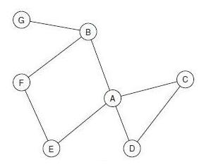
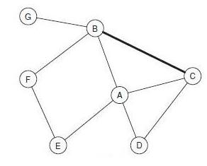
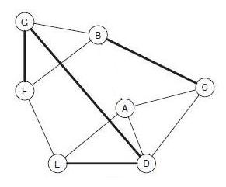
三元闭包与社会网络演化（Evolution）
现象
原理
网络结构特征
时间
不仅考虑一个时刻（“快照”）上的性质
还要研究随时间发生的变化（内部原因 vs 外部原因）

Slide 26
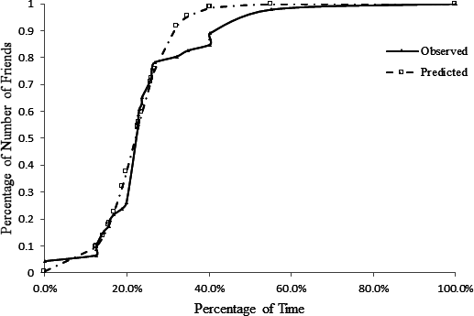
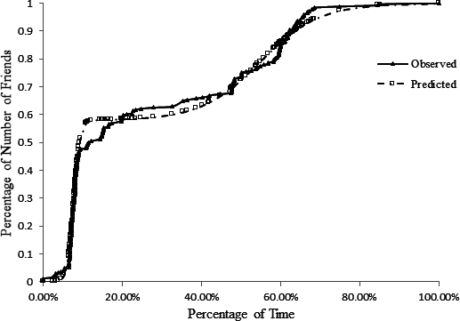
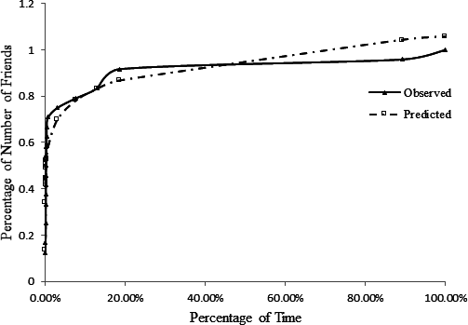
Trajectory of Friendship Formation (Zhang & Zhu, 2014)
The ability to observe hundreds of millions of people means we can measure differences with small effect sizes that might otherwise be swamped by random variability.
Notes:
1、小数据无法发现差别；
2、行为模式与

Slide 27
传播模式
微观：
个体节点传播能力
个体信息传播行为 （信息多样性，etc）
宏观：信息传播模型
经典信息扩散性
阈值模型
级联模型
传染病模型…
Broadcasting vs Diffusion
意见领袖与两级传播
说服理论

Slide 28
Structural Virality: Information diffusion on Twitter （Goel, et.al., 2015)
Notes:
经验性验证“两集传播”

Slide 29
Diversity of News Consumption (Zhang, Zheng, & Peng, 2017)

Slide 30
 | Model 1 Null model | Model 2 Unconditional linear growth model | Model 3Conditional linear growth model
Fixed Effects
Intercept | .09 (.001)*** | .82 (.002)*** | .60 (.01)***
H1: Time |  | -.0004 (.00001)*** | -.0002 (.00001)***
H2: Global Information Diversity |  |  | .79 (.04)***
H3:Time × Global Information Diversity |  |  | .02 (.0004)***
H4: Gender [0=Female, 1=Male] |  |  | .20 (0.002)***
H5: Global Information Diversity × Gender |  |  | .88 (.05)***
H6: Time × Gender |  |  | .03 (.0004) ***
Control Variables
Cell Phone Model [0=Android; 1=iOS] |  |  | .03 (.002)***
Activity (n.of.views) |  |  | .07 (.0002) ***
Economic Development Indicator [Quartile=1] |  |  | .004 (.01)
Economic Development Indicator [Quartile=2] |  |  | .01 (.01)
Economic Development Indicator [Quartile=3] |  |  | -.001 (.01)
Random Effect
Within-users Variability σ² | .28 (.0002)*** | .27 (.0002)*** | .17 (.0001)***
Intercept τ₀₀ | .09 (.001)*** | .09 (.001)*** | .15 (.002)***
Model Fit Statistics
-2LL | 5166559 | 5093905 | 3932104

Slide 31
传播内容
框架理论
议程设置理论
沉默的螺旋
公共舆论
Censorship
内容与演化

Slide 32
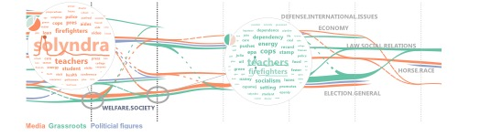
传播内容与传播效果
Xu, P., Wu, Y., Wei, E., Peng, T.-Q., Liu, S., Zhu, J. J. H., & Qu, H. (2013). Visual Analysis of Topic Competition on Social Media. IEEE Transactions on Visualization and Computer Graphics

Slide 33
Censorship (King, et.al., 2017)

Slide 34
谢谢！
张伦
北京师范大学数字媒体系
zhanglun@bnu.edu.cn
王成军
wangchj04@126.com
http://chengjunwang.com
Notes:
从事计算社会科学研究所面临的挑战
可能的合作方式？
提出问题
概念 & “讲故事”
计算
Manipulating unstructured data and nested data structures.
Manipulating and storing large data sets.
Machine learning, sentiment analysis, and topic modeling.

